Slide 1
Lecture 3
Data Warehousing and Mining
Unit I

Slide 2

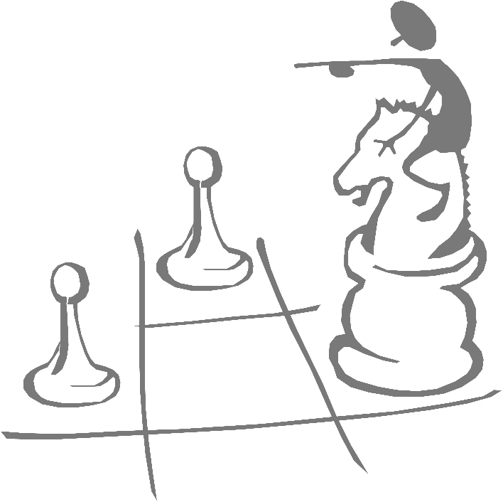
Working with Warehouse Data
Data Warehousing provides the Enterprise with a memory
Data Mining provides the Enterprise with intelligence

Slide 3
Operational Systems
Run the business in real time
Based on up-to-the-second data
Optimized to handle large numbers of simple read/write transactions
Optimized for fast response to predefined transactions
Used by people who deal with customers, products -- clerks, salespeople etc.
They are increasingly used by customers

Slide 4
Examples of Operational Data
Data
Industry
Usage
Technology
Volumes
Customer
All
Track
Legacy application, flat
Small-medium
File
Customer
files, main frames
Details
Account
Finance
Control
Legacy applications,
Large
Balance
account
hierarchical databases,
activities
mainframe
Point-of-
Retail
Generate
ERP, Client/Server,
Very Large
Sale data
bills, manage
relational databases
stock
Call
Telecomm-
Billing
Legacy application,
Very Large
Record
unications
hierarchical database,
mainframe
Production
Manufact-
Control
ERP,
Medium
Record
uring
Production
relational databases,
AS/400

Slide 5
Application-Orientation vs. Subject-Orientation
Application-Orientation
Subject-Orientation
Operational Database
Data
Warehouse
Credit
Card
Loans
Customer
Vendor
Product
Trust
Savings
Activity

